Slide 1


Slide 2
Agenda
Problem
Benifit & Impact
Business Idea
Demo
Architecture
Way forward
Q & A

Slide 3
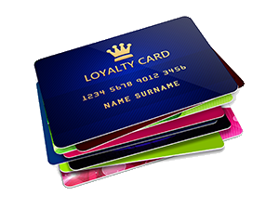

Current Problem
Notes:
Too many loyalty schemes $→$ Too many cards

Slide 4
Current Problem
Business affordability cost
62.07% of customers are unsatisfied with brand loyalty reward
Notes:
Affordability of associated costs for small businesses (incl. IT investment, Marketing, Rewards redemption etc.)
Too many loyalty schemes → Too many cards
62% of customers do not believe that brands are not doing enough to reward them for their loyalty, increasing the chance of consumer habits changing (according to Forbes)

Slide 5
Benefit & Impact
Retain existing customers
It is 5-10 times more profitable
Promotes brand image
Notes:
Gives ability to retain existing customers and increases customer loyalty (through rewards for purchasing behaviour)
Promotes brand image (by showing that the business cares for their loyal customers)
It is 5-10 times less expensive to keep existing customers than acquiring new customers

Slide 6
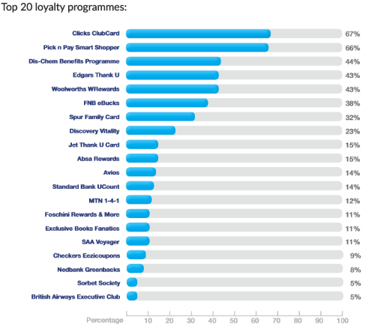
Benefit & Impact
Notes:
Pharmaceutical and Retail are leading loyalty programmes in SA.

Slide 7
Benefit & Impact
Notes:
According to Clicks ClubCard membership reports, customer base grow to 6.5 million members and these make up 77.4% of the sales for 2017.
From this it is clear to see that it is beneficial for a business to have a loyalty programme as members contribute large proportion of total sales.
Clicks ClubCard Membership grew to 6.5 Million Members

Slide 8
Benefit & Impact
77.4% of Sales Revenue
Notes:
According to Clicks ClubCard membership reports, customer base grow to 6.5 million members and these make up 77.4% of the sales for 2017.
From this it is clear to see that it is beneficial for a business to have a loyalty programme as members contribute large proportion of total sales.
Clicks ClubCard Membership grew to 6.5 Million Members

Slide 9

Small Business Partnerships
“Main objective of a partnership is the synergy of 1 + 1 = 5, instead of 2”
Scott Schnurr
Access to a new market + products
Strategic partnerships
Notes:
Access to a new market as well as products
Therefore Strategic partnerships will better serve the needs of your customers when formed with the right businesses
Strategic partnerships better serve the needs of your customers

Slide 10
Aim of
Create accessibility to loyalty/rewards programs for small businesses
Incentivise customers to support small businesses
Facilitate partnerships between businesses
Remove the loyalty card system

Slide 11


Slide 12


Slide 13
Architecture

Slide 14
Potentials is endless…
Notes:
This slide is for the way forward
role out plan included

Slide 15


